Slide 1


Informational Meeting

Slide 2

Welcome
Notes:
Welcome attendees. Introduce self as the Program Organizer and anyone who one who will be assisting you.

Slide 3
What is unique
about an
ACTS®
travel program?

Slide 4
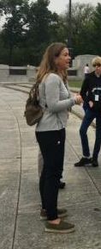
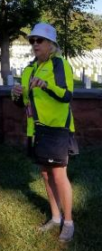
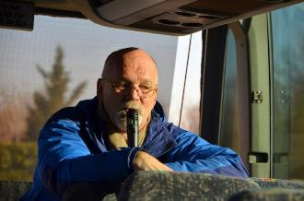
The ACTS Team
  ^{Program Leaders –}
  Experienced, passionate, dedicated believers who are trained and prepared to impact and inspire through insightful stories, interactive discussions, devotional moments, and prayer.
  ^{Office Staff –}
  Professionalism and excellent service are our trademarks from start to finish!
Notes:
The ACTS Team of experienced professional staff is dedicated to providing excellent service!
Office staff: Program Consultants, Reservations Staff, and the Operations Staff who works behind the scenes on all the details.
Road staff: Program Leaders – all ages, backgrounds, from across the nation

Slide 5
ACTS Programs
Christ-centered “Big Idea” theme
US History communicated through the lens of a biblical worldview—inspiring learning, critical thinking, and practical application
The stories of Pilgrims, Patriots, and Heroes need to be remembered if we are to preserve our freedoms for posterity.
Notes:
ACTS has developed their own “curriculum” that weaves biblical themes and concepts together with the stories of US history.

Slide 6
Unmatched Financial Protection
All monies are held in an FDIC-insured trust account administered by an independent firm of Certified Public Accountants. Funds are not released to ACTS until after your program has completed.
$$
Notes:
Money in protected and safe. Any monies used prior to trip completion are to cover deposits on trip-related expenses such as airlines, hotels, etc.

Slide 7
Program Itinerary
  Highlights of itinerary
  Planned with adults in mind
  Itinerary details are subject to change based on availability of attractions
Notes:
See Participant Registration Handout

Slide 8
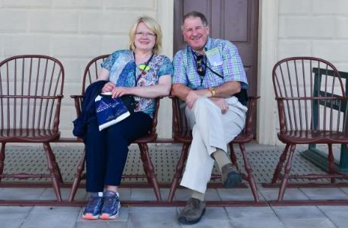
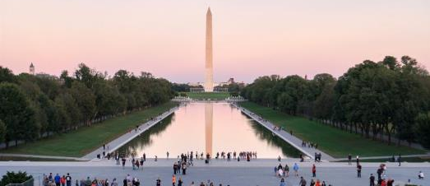
The places we’ll go!
Notes:
Delete or skip slides that do not apply to your program.

Slide 9
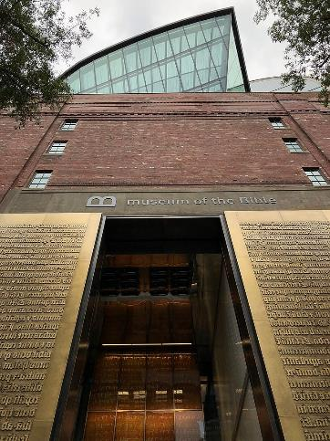

Museum of the Bible
Notes:
Explore the Museum of the Bible’s many exhibits including the Bible in American, The Hebrew Bible, The New Testament Theater, The World of Jesus of Nazareth, and the History of the Bible.

Slide 10
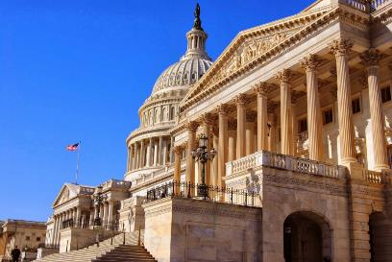
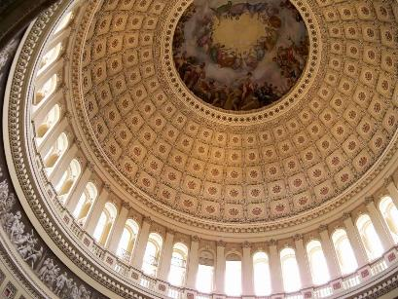
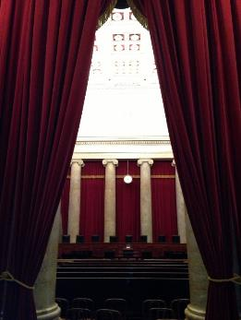
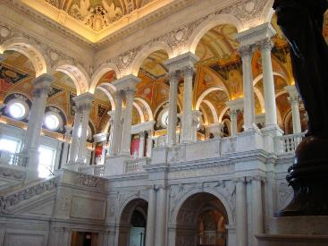
Capitol Hill
Notes:
Left to right: US Capitol building, inside the Library of Congress, inside the US Supreme Court, looking up at the Capitol rotunda

Slide 11
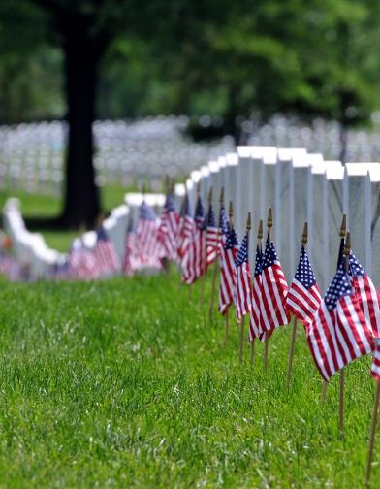
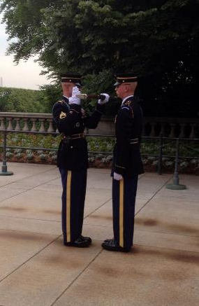
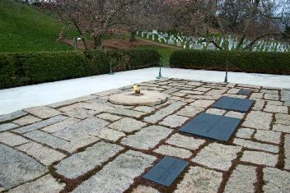
Arlington Cemetery
Notes:
Left to right: Flags at Arlington National Cemetery, the Eternal Flame at President Kennedy’s gravesite, guards at the Tomb of the Unknown Soldiers

Slide 12
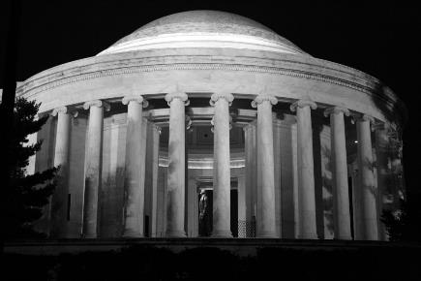
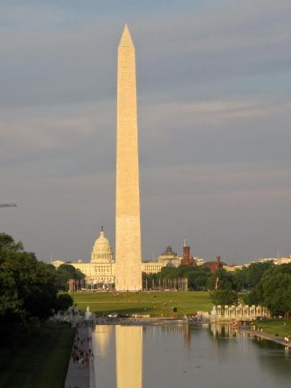
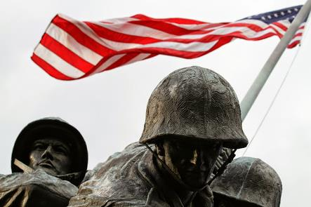
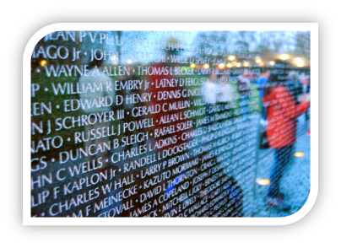
Washington Memorials
Notes:
Left to right: Jefferson Memorial, the Vietnam Veteran’s Memorial Wall, the Washington Monument, the U.S. Marine Corps Memorial (Iwo Jima Memorial)

Slide 13
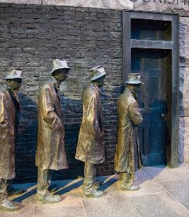
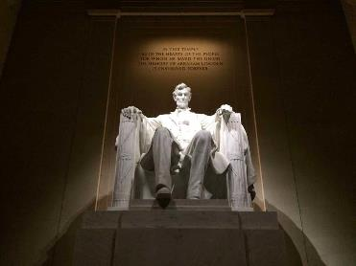
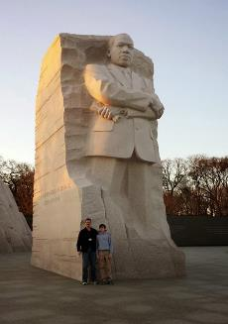
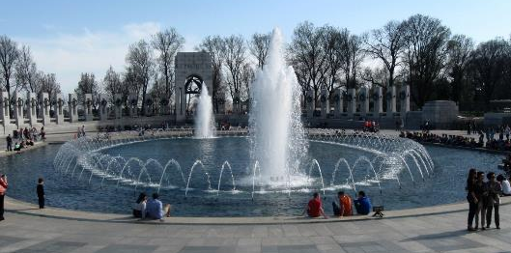
Washington Memorials
Notes:
Left to right: Breadline at the Franklin Roosevelt Memorial, World War II Memorial, Lincoln Memorial, Martin Luther King, Jr. memorial

Slide 14
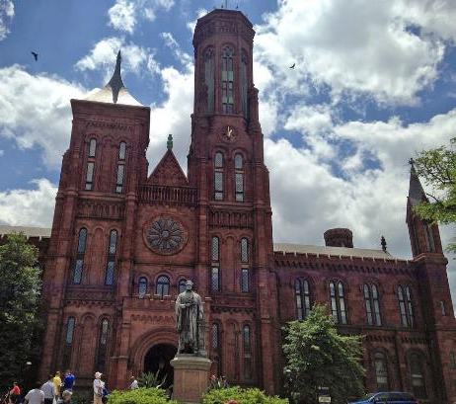
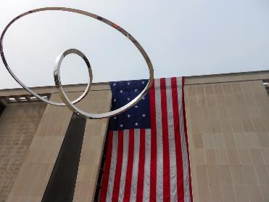
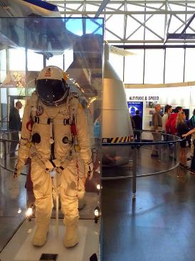
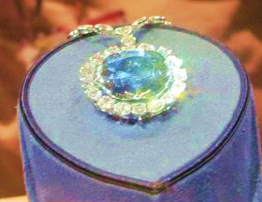
Smithsonian Institution
Notes:
Left to right: Flag hanging outside the American History Museum, spacesuit at the Air and Space Museum, the Smithsonian Castle, the Hope Diamond

Slide 15
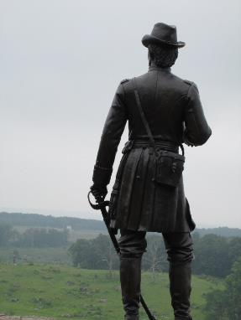
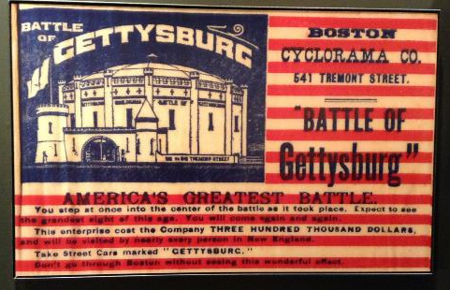
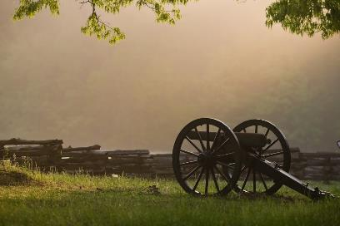
Gettysburg, PA
Notes:
Left to right: Brig. Gen. Gouverneur K. Warren on Little Round Top, view of the battlefield, an artifact from the Gettysburg Museum and Visitors Center

Slide 16
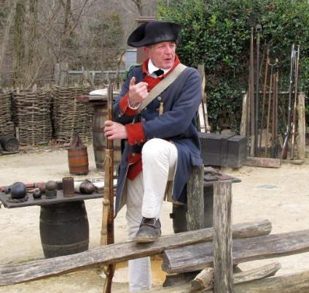
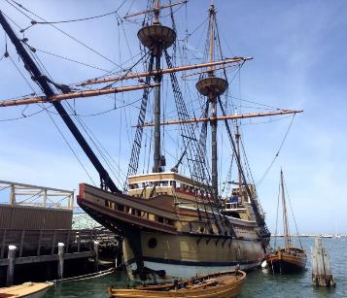
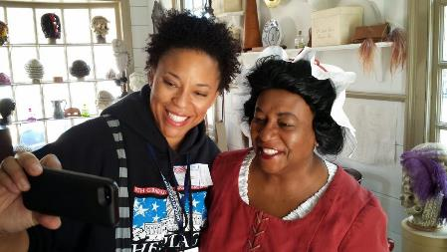
The Historic Triangle
Jamestown - Colonial Williamsburg – Yorktown
Notes:
Left to right: The Susan Constant at Jamestown, the wigmaker’s shop in Colonial Williamsburg, an interpreter at Yorktown

Slide 17
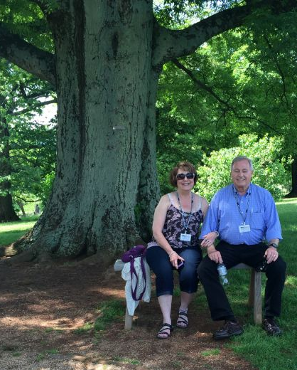
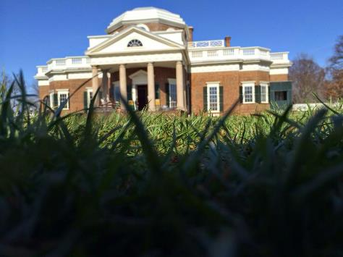
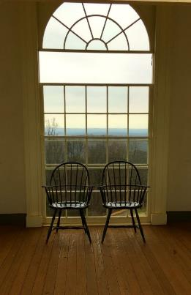
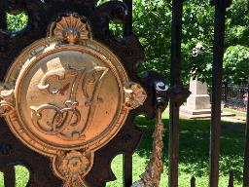
Monticello: The home of Thomas Jefferson
Notes:
Left to right: On grounds of Monticello, a view from inside the house, monogrammed gate, the view found on a nickel!

Slide 18
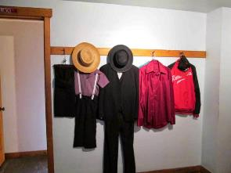
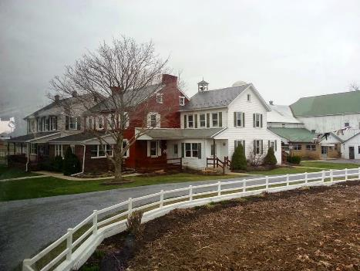
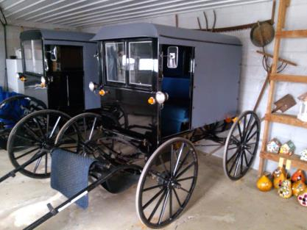
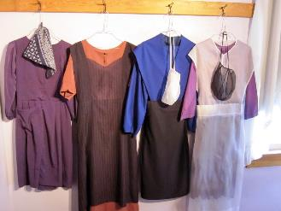
Amish Country
Lancaster County, PA
Notes:
Left to right: Displays of modern Amish clothing at an Amish farmhouse, Amish buggies, an Amish generational farmhouse

Slide 19
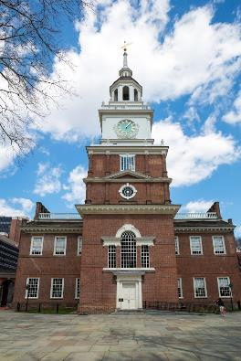
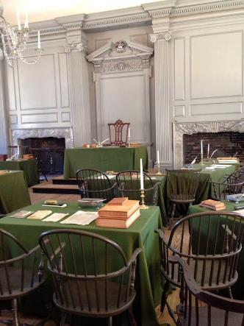
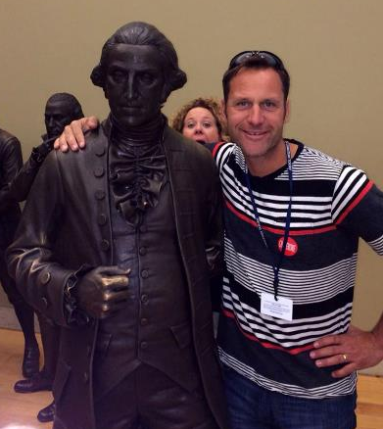
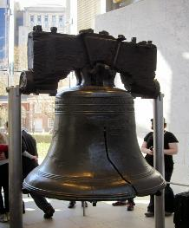
Philadelphia
Notes:
Left to right: Independence Hall, Liberty Bell, Assembly Room (where the Declaration of Independence and Constitution were drafted and signed), George Washington and a friend at the Constitution Center Hall of Signers

Slide 20
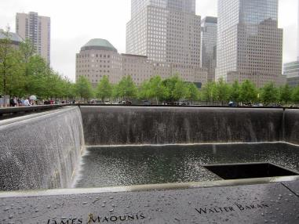
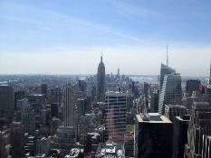
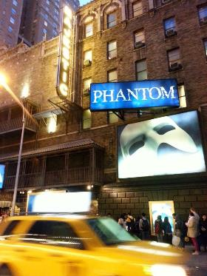
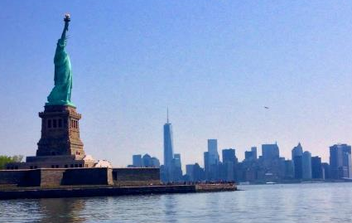
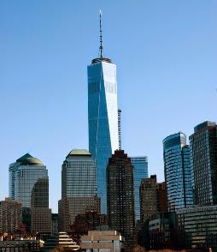
New York City
Notes:
Left to right: 9/11 Memorial at Ground Zero, One World Trade Center – “Freedom Tower,” Statue of Liberty, view from Top of the Rock, a Broadway show

Slide 21
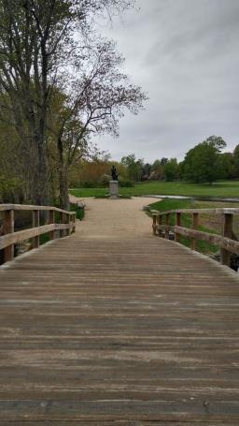
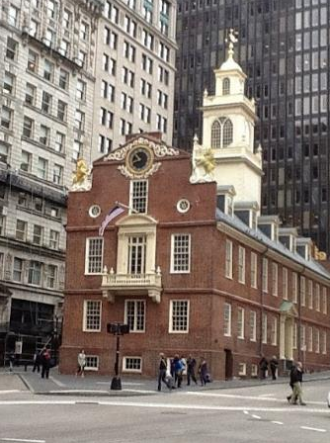



Boston and Plymouth
Notes:
Left to right: Along the Freedom Trail, the Forefather’s Monument in Plymouth, Plymouth Rock, Old North Bridge in Concord

Slide 22




Sacramento
Notes:
Left to right: Wagon at Sutter’s Fort, Old Town Sacramento, California State Capitol building, gold panning tools

Slide 23




San Francisco
Notes:
Left to right: Golden Gate Bridge, cable car ride, Alcatraz Island, Fishermans Wharf

Slide 24




Yosemite National Park
Notes:
Left to right: Mirror Lake, Bridal Veil Falls, Yosemite Valley

Slide 25



Grand Canyon - Arizona
Notes:
Left to right: Grand Canyon view, “Pink Jeep Tour” in Sedona, Calico “Ghost Town” near Yermo, CA

Slide 26




“The March” – Civil War to Civil Rights
Notes:
The group travels from Memphis to Atlanta learning about the time between the Civil War and the Civil Rights Movements. Stops may include
From left to right: National Civil Rights Museum / Lorraine Motel in Memphis, TN; the 16th Street Baptist Church in Birmingham, AL; the Edmund Pettus Bridge in Selma, AL; Martin Luther King, Jr.’s grave in Atlanta.

Slide 27



Texas State History
Notes:
Left to right: Texas State Capitol in Austin, the Alamo in San Antonio, Texas Longhorns

Slide 28






Illinois State History
Notes:
Left to right: Chicago, boat tour on the Chicago River, models of the Lincoln Family at the Lincoln Museum in Springfield, Lincoln’s home, Lincoln’s tomb, statue of the Lincolns

Slide 29
A Typical Day
Wake up call at 7:00 am
Breakfast at 8:00 am
Full day visiting sites and attractions
Lunches at cafés or food courts
Evening meals at established restaurants
Evening memorial tours
Return to hotel between by 8:00 PM
Notes:
A typical Day
Hotel wake up call around 6:30am
Breakfast an hour after wake up call
On the road a half hour later
Busy visiting attractions all day with a food-court-type option for lunch
Dinner is usually a buffet, or a limited menu at a restaurant
Evening activities
Usually arrive back at the hotel around 9:00pm
About 15 minutes from hotel arrival till curfew (in their rooms)
Lights out will be assigned each night based on the schedule and the needs of the group
Security or ACTS staff will be in the hallway throughout the night

Slide 30


An opportunity to learn
Benefits of an ACTS®
Travel Program
An opportunity for fellowship
An opportunity for spiritual refreshment
Notes:
An opportunity to learn: Program leader teaching throughout program in addition to docents, guides, exhibits, museums, etc.
An opportunity for fellowship: Time spent with others who have shared interest in US history, Christian history, and applying a biblical worldview to events of the day
An opportunity for spiritual refreshment: Daily devotions and times of prayer, encouragement from Christian examples from history, charged with making a different in sphere of influence

Slide 31


Participant Registration Handout
This includes information for online registration and the anticipated itinerary.
Notes:
Distribute the Participant Registration Handouts (PRHs). The PRH includes the information needed to register online (trip code and password) and the anticipated itinerary.

Slide 32
Program Registration and Options
Online Registration
Rooming Options
Payment Schedule
Payment Options
Cancellation Policy
Cancellation Options
Notes:
Explain the fees and options available.
Investment amount (overall cost of program)
Online Registration (see Participant Registration Handout)
Website address
Tour Code
Password
Set up an account with a username (email address) and personal password
Rooming options
Adult Double
Adult Single Supplement
Room assignments will be addressed later in the process
Payment schedule
Deposit, second, and final payment dates and amounts
Smaller payments can be made anytime online; minimum payment $25
After payment due dates, there is a 10-day grace period, after which a late fee of $15 is charged
Types of Payment options
Credit Card
Pay Pal
Check or money order
Cancellation Policy
Most lenient in group travel industry
The deposit is non-refundable and non-transferable.
Cancellation within 50 days of trip departure, refunded amount paid except:
- 1½ times the deposit
- any non-refundable ticket items purchased on your behalf
Cancellation within 8 days of trip departure = no refund
Personalized cancellation options can be purchased at www.travelguard.com.

Slide 33
Questions & Answers
Notes:
Q&A
There are additional resources in the organizer e-office and FAQs on ACTS website. Your ACTS Program Consultant is another excellent resource.

Slide 34
Thank You For Attending!
Let’s Have A Great Trip!
Notes:
Encourage people to sign up as soon as possible!

