Slide 1


Education Program
Informational Meeting
Notes:
Welcome families as they enter. If possible, collect email addresses on a laptop or sign-in sheet so you can email the Electronic Sign-up Registration (Participant Registration Handout/PRH) to each person. They can sign-up during the meeting!

Slide 2
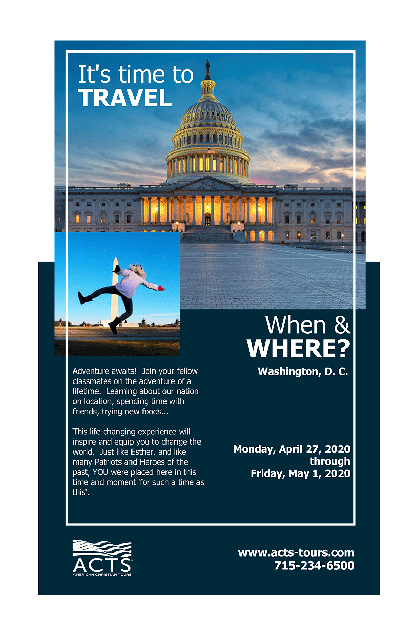
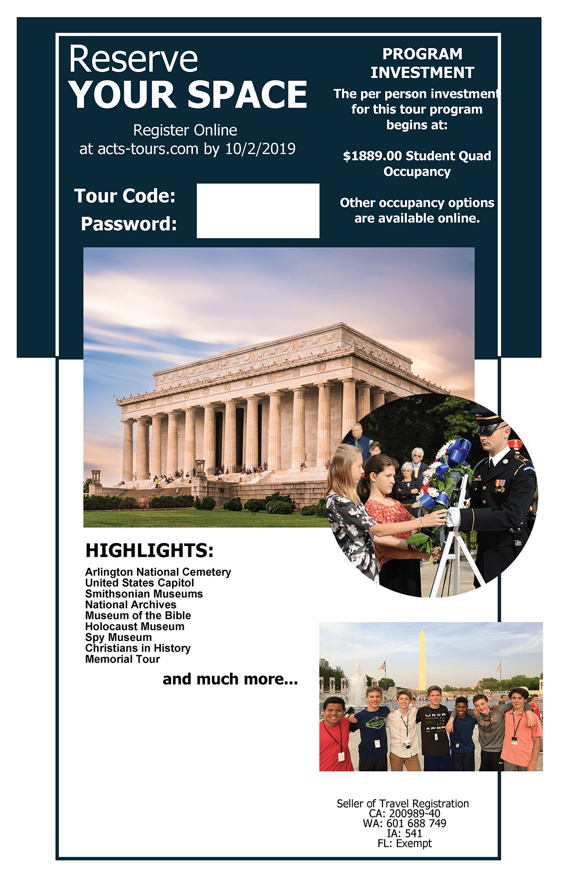
Participant Registration Handout
Notes:
This is the time to distribute the Participant Registration Handouts (PRH’s). The PRH includes the information participants will need to register online (like the trip code and password) and has a list of highlights!

Slide 3
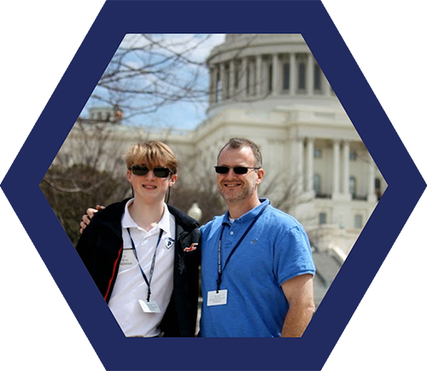
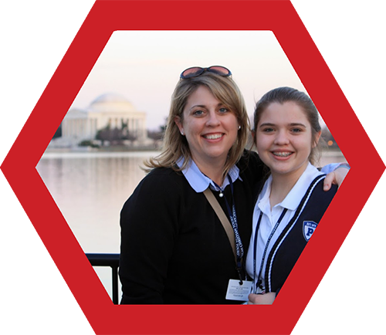
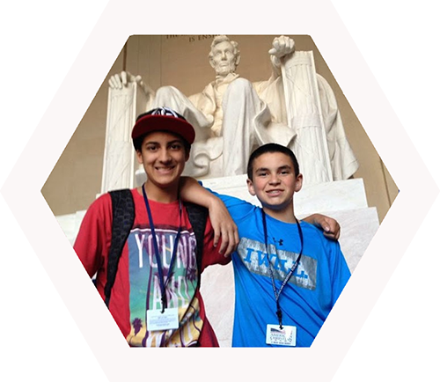
Welcome
Notes:
This is a time to open your meeting. Welcome everyone who took the time to attend. Express your excitement to share in the educational journey to learn more about our nation and the Gospel. You should introduce yourself to the group as the Program Organizer and also introduce any additional staff members who will be going on the program.

Slide 4

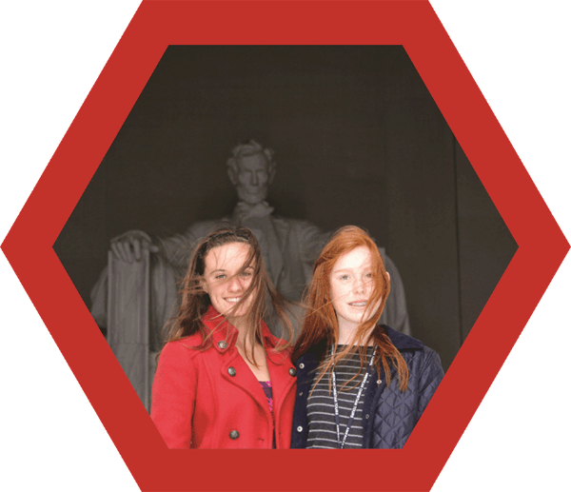
Only
Life
What Sets
ACTS®
Programs
Apart?
ONE
Notes:
The leading slide to talk about what sets ACTS Programs apart from other student education travel providers.

Slide 5

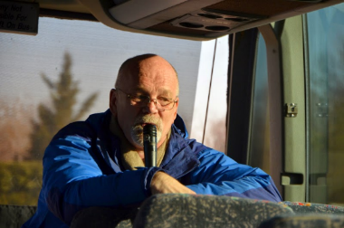
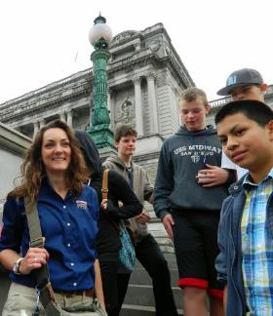
Our Team
^{- Education Program Leaders}
^{- Office Staff}
Notes:
Our Team of experienced professional staff from our Education Program Leaders (EPLS) to our office staff of Consultants and Operations and Reservation associates are all dedicated to providing you and your group with excellent service.
^{Education Program Leaders –}
Experienced passionate, dedicated believers who are trained and prepared to impact students and adults with insightful stories, lead in interactive discussions, and inspire with devotional moments and prayer.
^{Office Staff –}
Professionalism and excellent service are our trademarks as we partner with you from start to finish

Slide 6
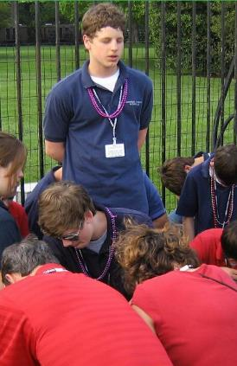

Our Programs
^{- The Big Idea}
^{- Student Travel Journals}
Notes:
Our programs are Christ-focused. We strive to communicated our history through the lens of biblical worldview with critical thinking and practical applications.
The Big Idea –
history communicated from the lens of a biblical worldview inspiring learning and critical thinking and practical application
Student Travel App –
an educational tool that will include information, games, weblinks, and videos for additional learning and discovery

Slide 7
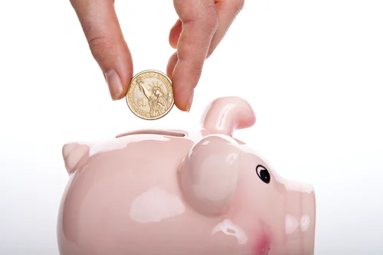
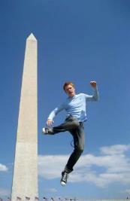
Unmatched Financial Protection
Notes:
Monies are transferred by the CPAs to cover deposits on trip related expenses such as airlines, hotels, etc. prior to the trip completion.
All monies are held in a FDIC insured trust account administered by an independent firm of Certified Public Accountants. Funds are not released to ACTS until after your program has completed.

Slide 8

Accredited Education Programs
Notes:
NOTE: As a school you are able to award credits based on the completion of an ACTS Education Travel Program.
Cognia has accredited American Christian Tours as a Travel School.
High School students completing an ACTS Education Travel Program are provided with a certificate of completion.

Slide 9
Education Program Itinerary
  Planned with students in mind
  The actual itinerary scheduled is subject to change based on availability of attractions
Notes:
This is the time to talk about the Itinerary of the Education Program. You should highlight the major cities and areas that will be visited. The current itinerary is able to be viewed online (it changes often, but trust we will pack in as much as humanly/legally possible!)

Slide 10
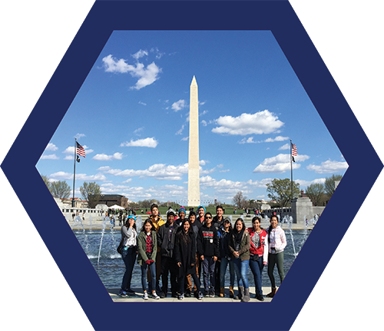
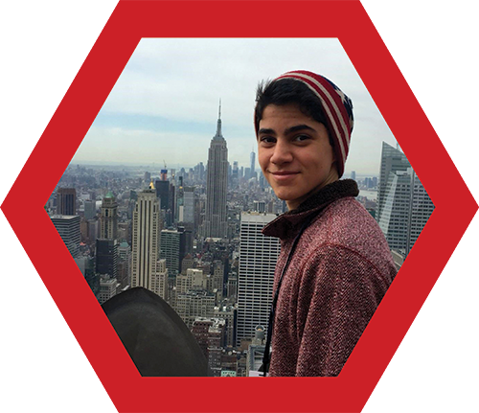
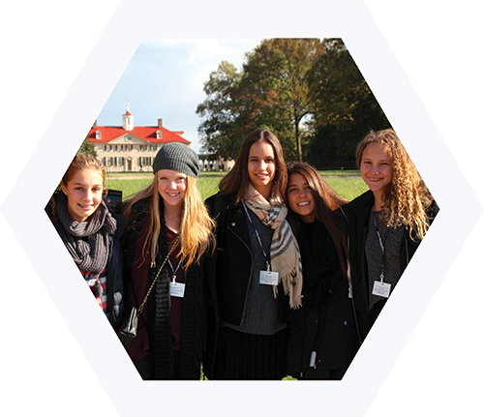
Some of the places you may see!
Notes:
Program Organizer – please pull out the slides, from the slides that follow, that do NOT pertain to your Education Program, or skip over them.

Slide 11
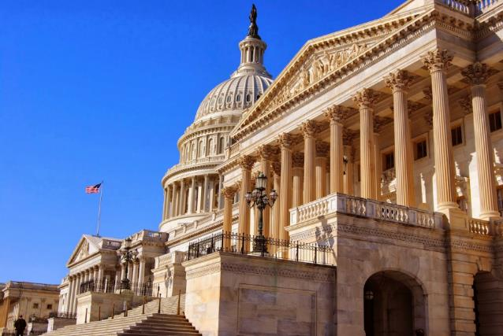
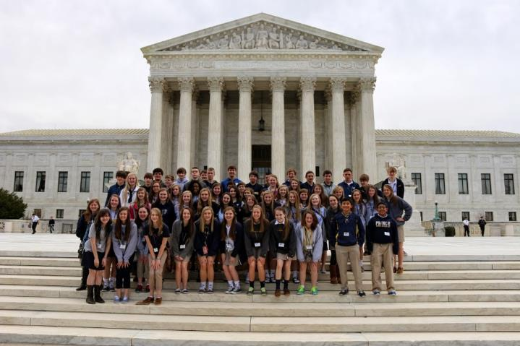
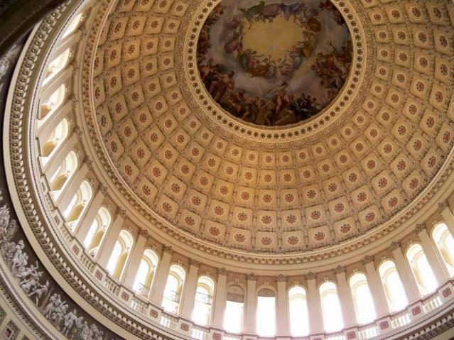
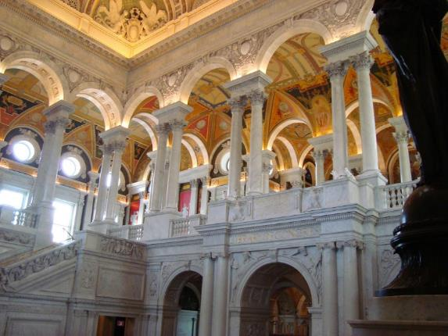
Capitol Hill
Notes:
Capitol Hill. The U.S. Capitol Building, Inside the Library of Congress, outside the United States Supreme Court, looking up at the inside of the Capitol Rotunda.

Slide 12
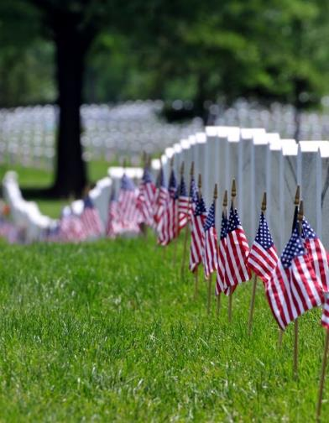
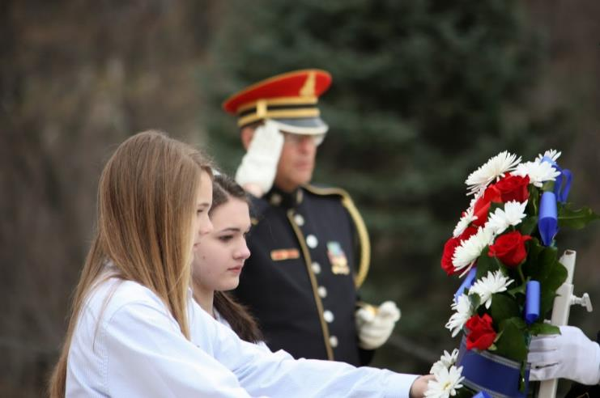
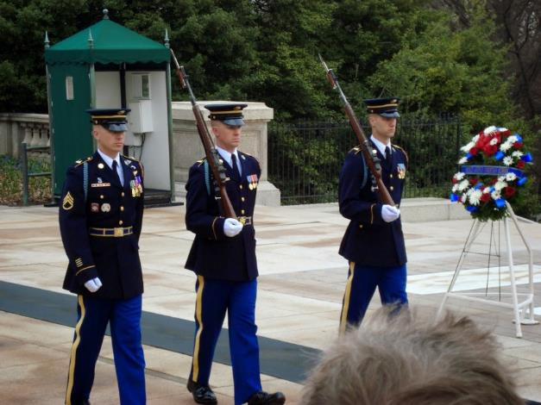
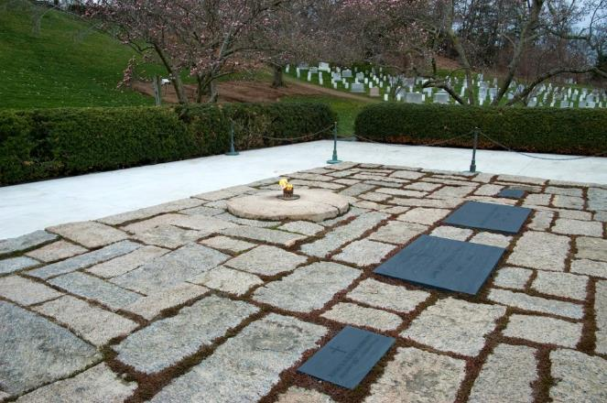
Arlington Cemetery
Notes:
Flags at Arlington National Cemetery. The Eternal Flame at President Kennedy’s gravesite. Laying a wreath at the Tomb of the Unknowns. Guards at the Tomb of the Unknown Soldiers.

Slide 13
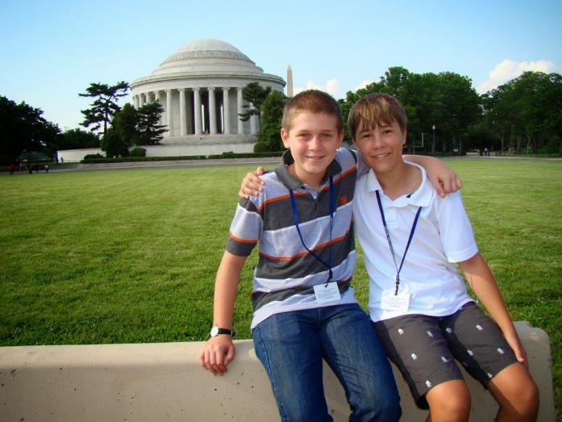
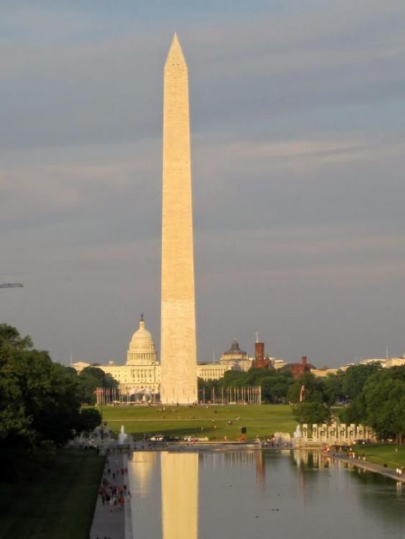
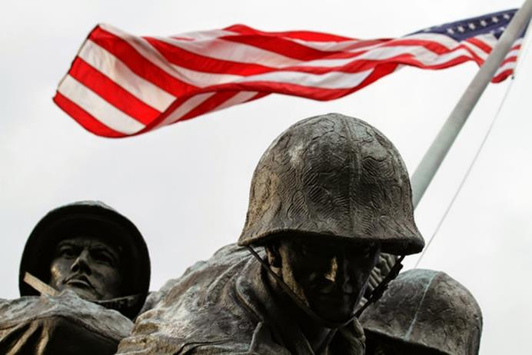
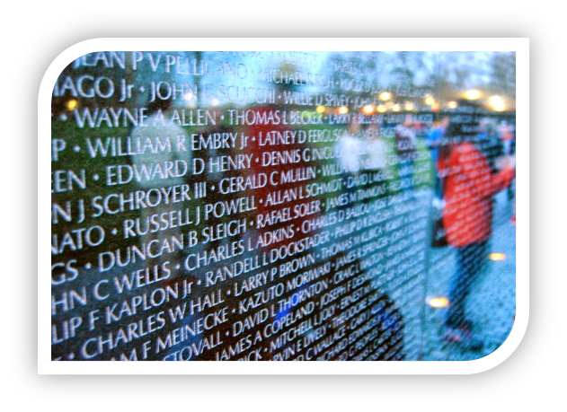
Washington DC Memorials
Notes:
Outside the Jefferson Memorial. Names of soldiers engraved on the Vietnam Veteran’s Memorial Wall. The Washington Monument. The U.S. Marine Corps Memorial (Iwo Jima Memorial).

Slide 14
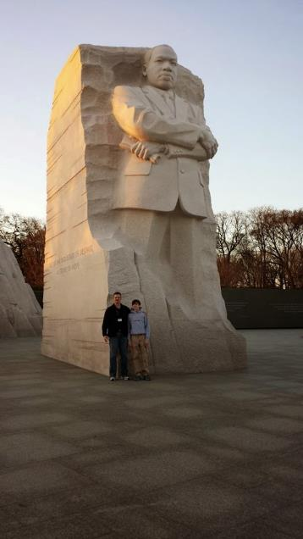
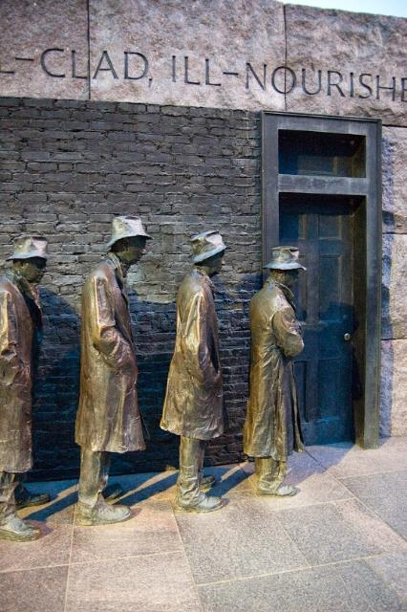
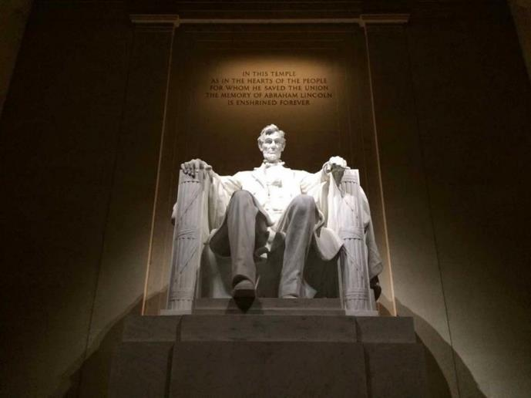
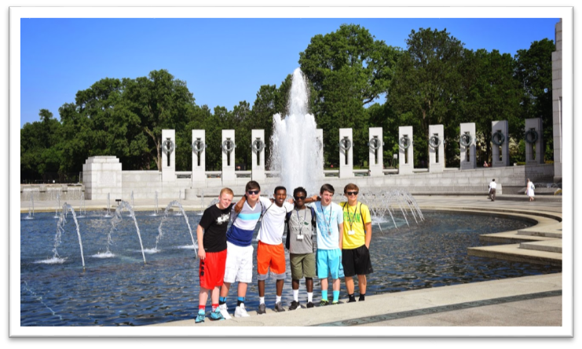
Washington Memorials
Notes:
Bread line at the Franklin Roosevelt Memorial. Students at the World War II Memorial. The statue of Abraham Lincoln at the Lincoln Memorial. The statue of Dr. Martin Luther King, Jr. at his memorial.

Slide 15
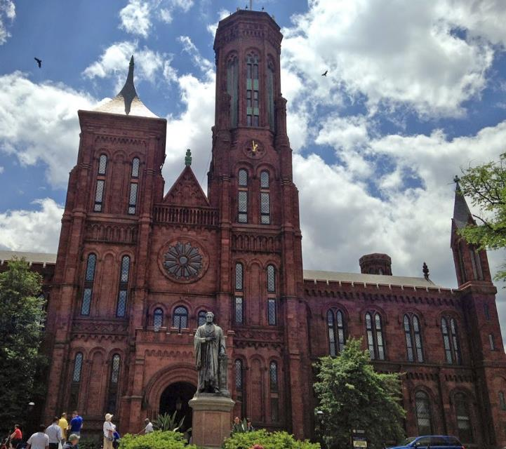
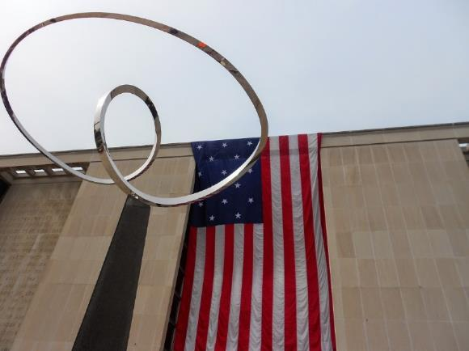
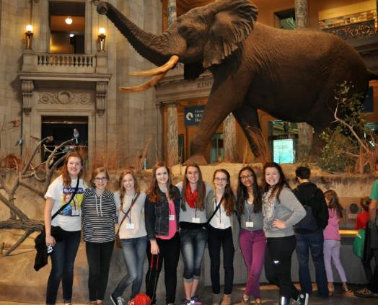
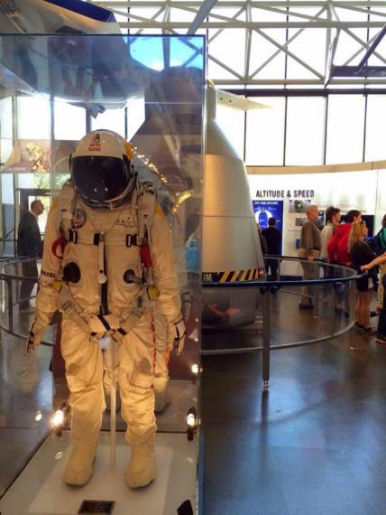
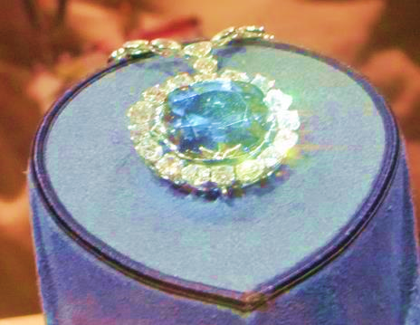
Smithsonian Institution
Notes:
Flag hanging outside the American History Museum. Spacesuit at the Air and Space Museum. The Smithsonian Castle (the original Smithsonian). The Hope Diamond. Students in the Natural History Museum.

Slide 16
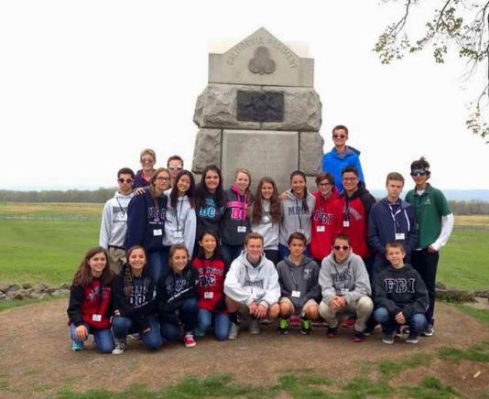
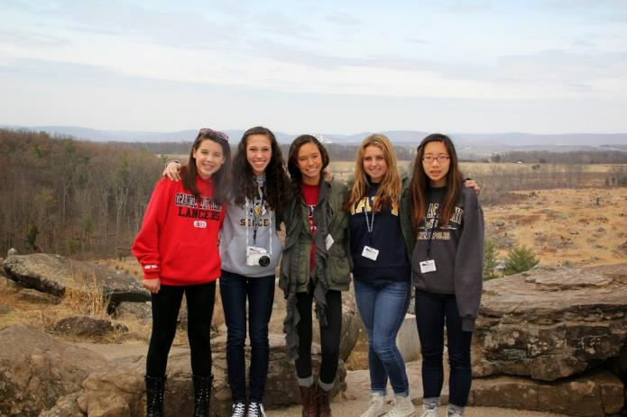
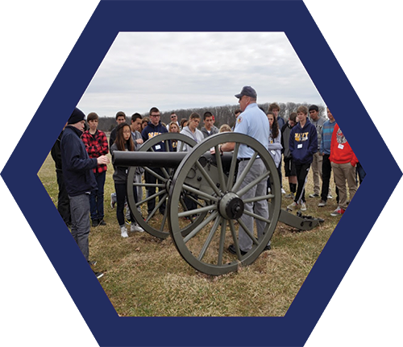
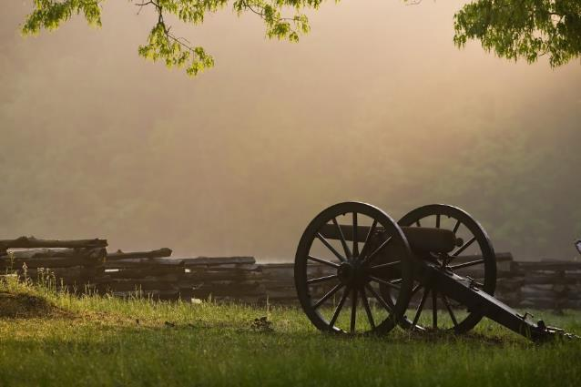
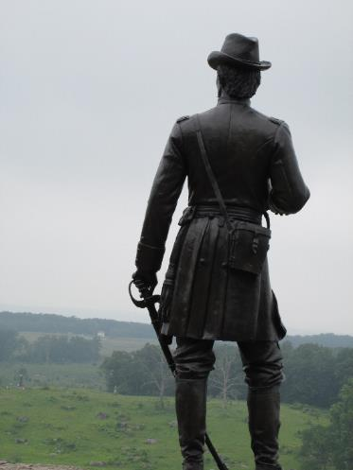
Gettysburg
Notes:
Students in front of a monument in Gettysburg. Statue of Gouverneur K. Warren on Little Round Top. Battlefield Tour Guide sharing with students. A cannon and fence at Gettysburg. Students overlooking the Gettysburg National Battlefield.

Slide 17
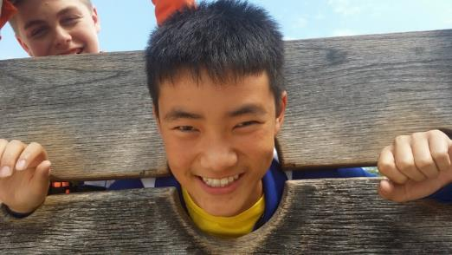
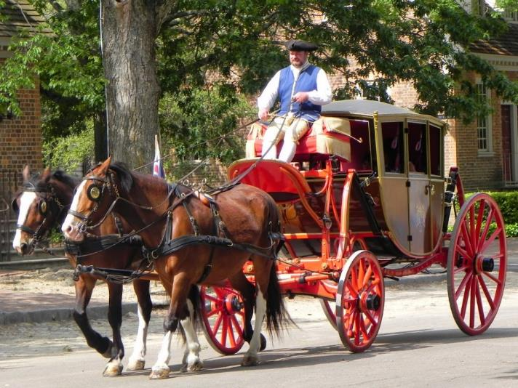
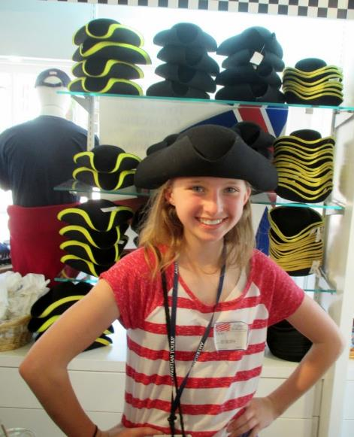
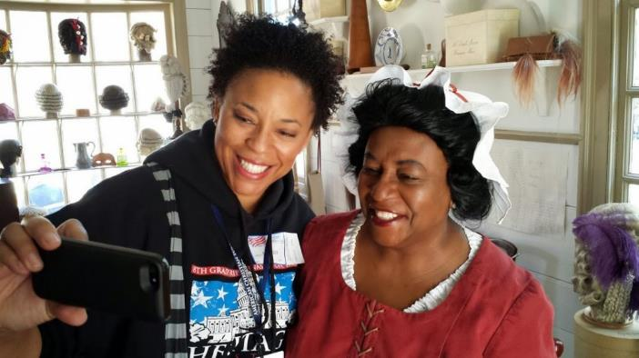
Colonial Williamsburg –
Historic Triangle
Notes:
Student in stocks in Colonial Williamsburg Market Square. Ladies in the Wigmaker’s Shop. A carriage on the Duke of Gloucester Street. Student trying on colonial tricorn hats.

Slide 18
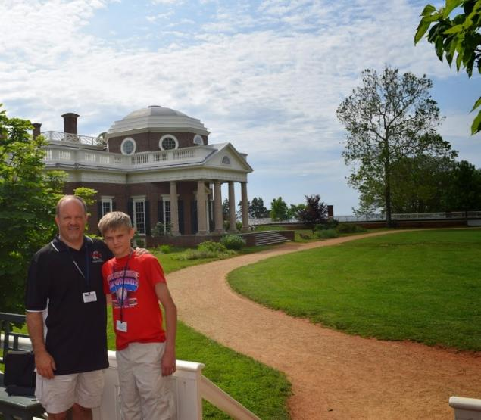
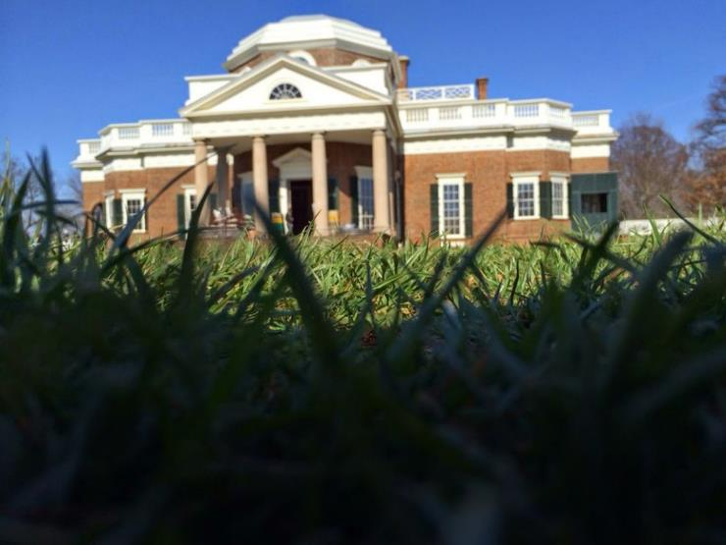
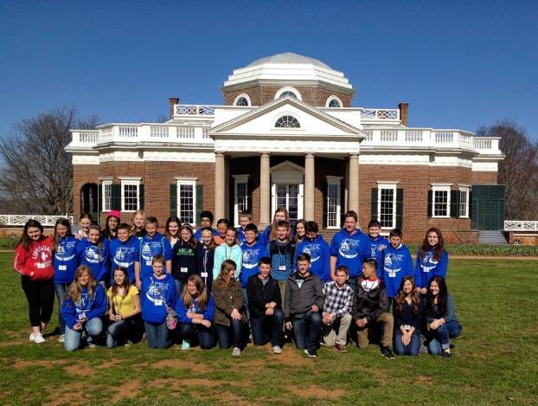
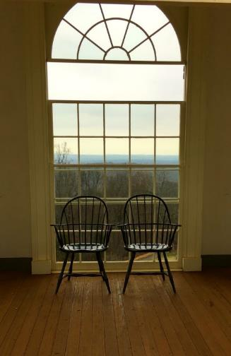
Monticello
Notes:
Student and parent on grounds of Monticello. Looking out a window at Monticello. The “nickel view” of Monticello. A group on the grounds of Monticello.

Slide 19
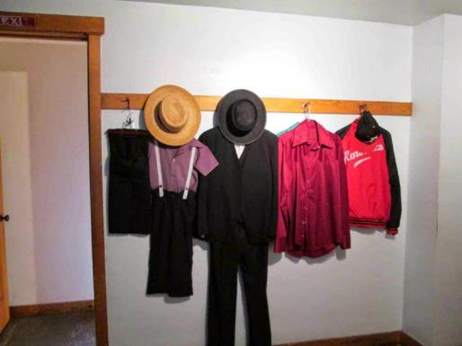
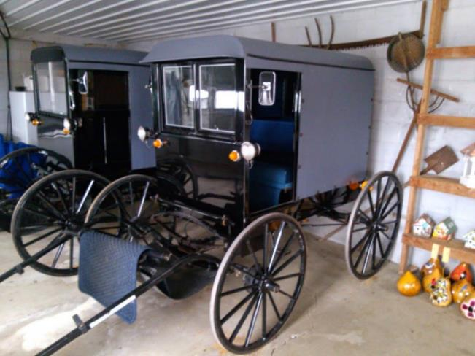



Amish Country
Notes:
Displays of modern Amish clothing at the Amish Farmhouse. Amish buggies on a farm site. Students in front of an Amish buggy. An Amish generational farmhouse.

Slide 20





Philadelphia
Notes:
Independence Hall. Liberty Bell. Students at the Liberty Bell. Assembly Room – room in which both the Declaration of Independence and Constitution were drafted and signed. Statue of George Washington in the Constitution Center Hall of Signers.

Slide 21




New York City
Notes:
Group of students at the Statue of Liberty. Girl getting into the spirit. Girls on 5th Avenue outside of Trump Tower. Girl at Top of the Rock.

Slide 22





New York City
Notes:
9/11 Memorial – Ground Zero. Rose left at 9/11 Memorial. One World Trade Center – “Freedom Tower.” Students in Times Square. A Broadway Show.

Slide 23


Creation Museum/Ark Encounter
Notes:
Creation Museum and Ark Encounter – Petting Zoo, Zip lines (if you allow)

Slide 24






Boston and Plymouth
Notes:
The site of the Boston Massacre along the Freedom Trail. Students in front of the Paul Revere Statue near the Old North Church. Students at the Forefather’s Monument in Plymouth. Students at Plimoth Plantation. Students on Old North Bridge in Concord, Massachusetts.

Slide 25





Sacramento
Notes:
Wagon at Sutter’s Fort. The Old Schoolhouse in Old Town Sacramento. The California State Capitol Building. ACTS EPL sharing in Old Town Sacramento. Students in the California State Railroad Museum.

Slide 26






Gold Country - Coloma
Notes:
Old gold miner pan, pick, and hammer. Group gold panning in the American River. ACTS EPL sharing at John Marshall’s cabin in Coloma. Girl panning for gold in the American River. The Marshall Monument in Coloma. Students in front of the replica Sutter Sawmill.

Slide 27





San Francisco
Notes:
The Golden Gate Bridge. Students viewing the Golden Gate Bridge. Students walking out to the Golden Gate Bridge. Students at Alcatraz Island. Students on a cable car ride in San Francisco.Students checking out the gifts of the seas Students checking out the fruit of the seas at Fisherman's Wharf San Francisco.

Slide 28




Yosemite
Notes:
Yosemite National Park. Mirror Lake. View of Yosemite Valley. Bridalveil Falls, Yosemite National Park.

Slide 29




Grand Canyon - Arizona
Notes:
Students on the South Rim of the Grand Canyon. Students on the “Pink Jeep Tour” in Sedona, Arizona. Calico – “Ghost Town,” near Yermo, CA on the way to Arizona (if motorcoaching from California).

Slide 30




“The March” – Civil War to Civil Rights
Notes:
Students outside the National Civil Rights Museum in Memphis. The Lorraine Motel where Dr. King was assassinated. Dr. Martin Luther King, Jr.’s Burial Site in Atlanta. Students at the Civil Rights Memorial (a memorial in Montgomery, Alabama).

Slide 31





The March – Civil War to Civil Rights
Notes:
Student sitting by a statue of Rosa Parks. Students trying on Civil War uniforms. The Edmund Pettus Bridge in Selma, Alabama – Scene of “Bloody Sunday” on the Selma to Montgomery March in which Civil Rights demonstrators were attacked with billy clubs and tear gas. A demonstration of the “Whites Only” and “Colored Only” drinking fountains. 16th Street Baptist Church in Birmingham where four young black girls were killed in 1963 with dynamite detonated by members of the Ku Klux Klan.

Slide 32



Texas State History
Notes:
The Texas State Capitol in Austin. Outside the Alamo in San Antonio. Texas longhorns on a ranch.

Slide 33






Illinois State History
Notes:
Chicago, Illinois. Boat tour on the Chicago River. Models of the Lincoln Family at the Lincoln Museum in Springfield. The Lincoln’s home in Springfield. Lincoln’s Tomb. Statue of the Lincolns in Springfield.

Slide 34



St. Augustine
Notes:
St. Augustine. St. Augustine Lighthouse. Castillo.

Slide 35
A Typical Day
Wake up call at 6:30 a.m.
Breakfast at 7:30 a.m.
Full day visiting sites and attractions
Making memories and learning as we go
Meals at food courts and buffets
Evening memorial tours and activities
Return to hotel between 9 - 10 p.m.
Notes:
A typical Day
Hotel wake up call around 6:30am
Breakfast an hour after wake up call
On the road a half hour later
Busy visiting attractions all day with a food-court-type option for lunch
Dinner is usually a buffet, or a limited menu at a restaurant
Evening activities
Usually arrive back at the hotel around 9:00pm
About 15 minutes from hotel arrival till curfew (in their rooms)
Lights out will be assigned each night based on the schedule and the needs of the group
Security or ACTS staff will be in the hallway throughout the night

Slide 36
Student Benefits of an ACTS® Education Program
Notes:
Title Slide to start talking about the Student Benefits of an ACTS Education Program – Points follow in the next three slides.

Slide 37






Education
History
Geography
Math
Science
English
Physical Education
Notes:
One benefit – Educationally.
History
Geography
Math – Budgeting spending money
Science – Museums, Natural science at outdoor venues
English – Writing journals and reports
Physical Education – a lot of walking

Slide 38


Social
Friends
Roommates
Away from home
Notes:
Another benefit – Socially.
There is a lot of social time for students to engage and interact with each other.
Spending time with friends. This program will often be their favorite school age memory.
Learning to work with roommates – sharing space, shower schedule, etc.
May be one of the first times away from home traveling, yet in a safe and controlled environment.

Slide 39



Spiritual
Daily Devotions
Historical examples
World Changer
Notes:
Another benefit – Spiritually.
Daily Devotions and times of prayer.
Study examples of Christian Character demonstrated throughout our nation’s history.
Challenge to be world changers for Christ in their home, school, community, and the world.

Slide 40



Chaperones
Please remember that this program has been designed with our students in mind.
Notes:
This section is a time for you to talk about your school’s specific requirements and expectations for chaperones and adult participants. Each school will be different.

Slide 41
Education Program
Investment
Online Registration
Payment Schedule
Insurance Options
Notes:
Here is where you will run through the investment required to participate in the Education Program, the rooming options, payment schedule and options, insurance options and the cancellation policy.
Investment amount
Online Registration
Website address
Tour Code
Password
As you register online you will set up your family account which will include your own username (email) and your personal password.
Rooming options
Student Quad
Adult Double Triple
Adult Single Supplement
We will work on room assignments later in the year
Payment schedule
Registration fee, 150, 120, 90 & 60-day (prior to departure) payment dates & amounts
Make smaller payments any time online, minimum payment of $25
Late fee of $15 is charged after 10 day grace period following the payment due dates
Family/Friend gifts - You can give them ACTS' website address, your email, and password then they can go in and make a payment for your child. Or they can mail a check or money order to our office, or call our office with a credit card.
Types of Payment options
Credit Card
Pay Pal
Check or money order can be sent by mail
Cancellation Policy
Most lenient in the student travel industry
Registration fee is non refundable and non transferable.
Participants cancelling more than eighty (80) days prior to trip departure will be charged the amount of the Registration Fee.
• Cancellations within eighty (80) Days prior to departure will be charged 20% of total Program cost
• Cancellations within sixty (60) Days prior to departure will be charged 35% of total Program cost
• Cancellations within forty (40) Days prior to departure will be charged 50% of total Program cost
• Cancellations within thirty (30) Days prior to departure will be charged 75% of total Program cost
• Cancellations within twenty (20) Days prior to departure will be charged 100% of total Program cost
Insurance options – feel free to reference our office and have them call us – but most programs qualify for Cancel For Any Reason insurance – and it is exactly that – participants can cancel up to 48 hours prior to departure for any reason. For a low cost! Details are in the registration process.

Slide 42
Fundraising Opportunities
Notes:
This is the time to present any fundraising opportunities that may be available at your school for the ACTS Education Program.

Slide 43

What are others saying?
Notes:
Click on the video to be brought to a 1-minute clip of a parent sharing their experience.

Slide 44
Questions & Answers
Notes:
This is the time to open up for any questions that participants may have. We trust that in conjunction with the other information you have received in your personal e-office, most of your questions will have been answered. Of course, if you are faced with a question for which you do not have the answer, please contact your ACTS Education Program Consultant for the assistance you need.

Slide 45
Let The Fun Begin!
Notes:
You can personalize the school name, tour code and password in these boxes. Introduce how to register online.

Slide 46



Let's Register Online!
Visit:
https://www.acts-tours.com
Click on the yellow
LOG-IN/REGISTER button
That will bring you to our registration page.
Choose
“View Program & Register”
If this is your first time traveling with ACTS

Slide 47

Registering Online Continued
First, Create an Account!
You may modify the account contact name, address, email, and password in the future.
Once your account is created, select "Make a New Reservation" to start your adventure!

Slide 48

Thank You For Attending!
Let’s Have A Great Trip!
Notes:
Thank everyone for attending. You may wish to close in prayer. Encourage people to sign up, and we all will be looking forward to a great trip together!

